Slide 1

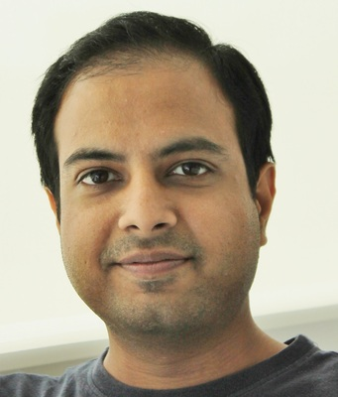

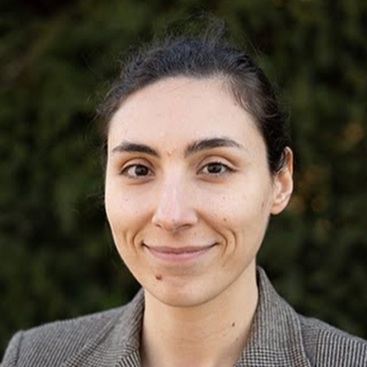
Deep Neural Networks and Brain Alignment: Brain Encoding and Decoding
Subba Reddy Oota¹, Manish Gupta^{2,3}, Raju S. Bapi², Mariya Toneva⁴
¹Inria Bordeaux, France; ²IIIT Hyderabad, India; ³Microsoft, India; ⁴MPI for Software Systems, Germany
subba-reddy.oota@inria.fr, gmanish@microsoft.com, raju.bapi@iiit.ac.in, mtoneva@mpi-sws.org

Slide 2
Agenda
Introduction to Brain encoding and decoding [30 min]
Stimulus Representations [1 hour]
Coffee break [30 min]
Deep Learning for Brain Decoding [1 hour 30 min]
Lunch break [1 hour 30 min]
Deep Learning for Brain Encoding [1 hour 30 min]
Coffee break [30 min]
Advanced Methods [1 hour 15 min]
Summary and Future Trends [15 min]

Slide 3
Outline
Summary
Future trends

Slide 4
Summary
Exciting times: publicly accessible neuroimaging data of various tasks starting to be avaliable now!
Opportunities:
Data ahead of theory, so it’s an open field for theoretical and methodological innovation!
Encoding models can be interpreted as process models constraining brain-computational theories (Kriegeskorte and Douglas, 2019).
Decoding models serve as a test for the presence of information in neural responses (Karamolegkou et al., 2023)
Decoding is relevant for cognitive neuroscientists interested in how semantic information is represented in the brain.
Computational linguists are interested in the cognitive plausibility of distributional models. (Minnema & Herbelot, ACL 2019)
DL is helpful in uncovering patterns in brain responses and may lead to theories of information organization in the brain.
Challenges:
Hypothesis-driven data collection might be more helpful
Individual variability is the norm in neuroimaging data!
Neuroimaging data is more complex, noisy as compared to classical datasets used by DL researchers

Slide 5
Summary
This Tutorial:
Stimulus representation schemes
Vision: CNN-based
Language: Transformer-based
Datasets available (Reading/Listening/Viewing tasks in EEG, MEG, fMRI)
Decoding
Word-level Universal Brain Decoder; Continuous Lang Decoding; Multi-view and Cross-view Decoding
Encoding
Classical findings; More recent DL-based models
Advance methods
Tuning/Training DL models using brain recordings
Task-based modeling

Slide 6
Outline
Summary
Future trends: DNNs & The Brain

Slide 7
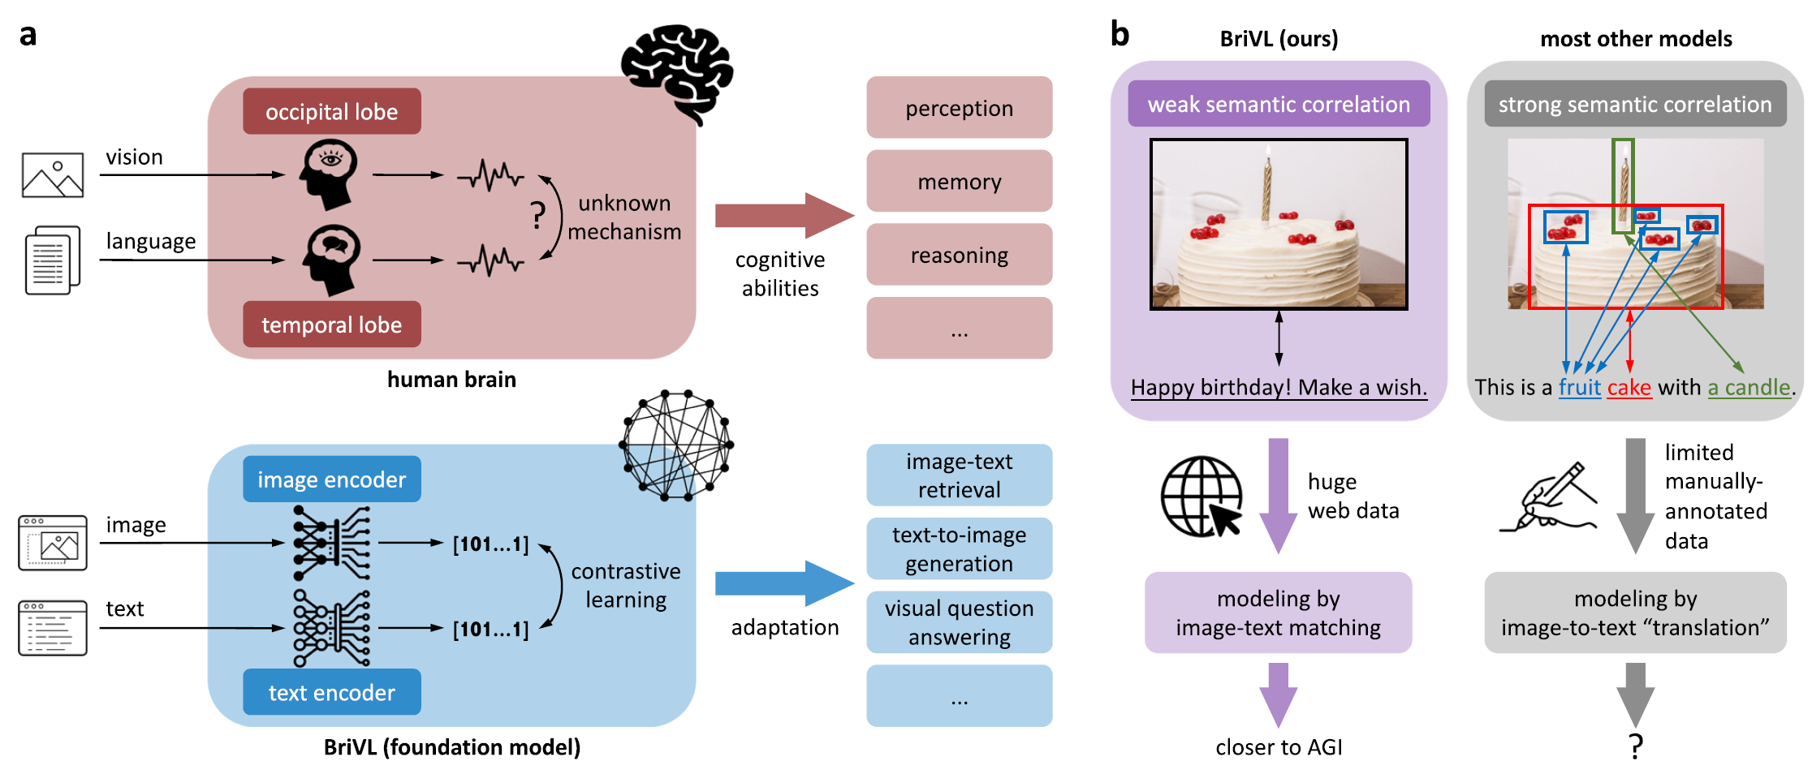
DNNs & The Brain: Multi-modal, Multi-task
Brain response to a stimulus is multi-modal, multi-task related
Cross-view and multi-view decoding (Oota et al 2022a)
Visio-linguistic encoding (fusion of vision and language information) (Oota et al 2022b)
Task-based representations give better brain alignment (Neural Taskonomy: Oota et al 2022c)
Multimodal foundation model (Fei et al 2022)
Fei, Lu, Gao et al (2022). Towards artificial general intelligence via a multimodal foundation model. Nature Communications 13:3094
doi.org/10.1038/s41467-022-30761-2

Slide 8
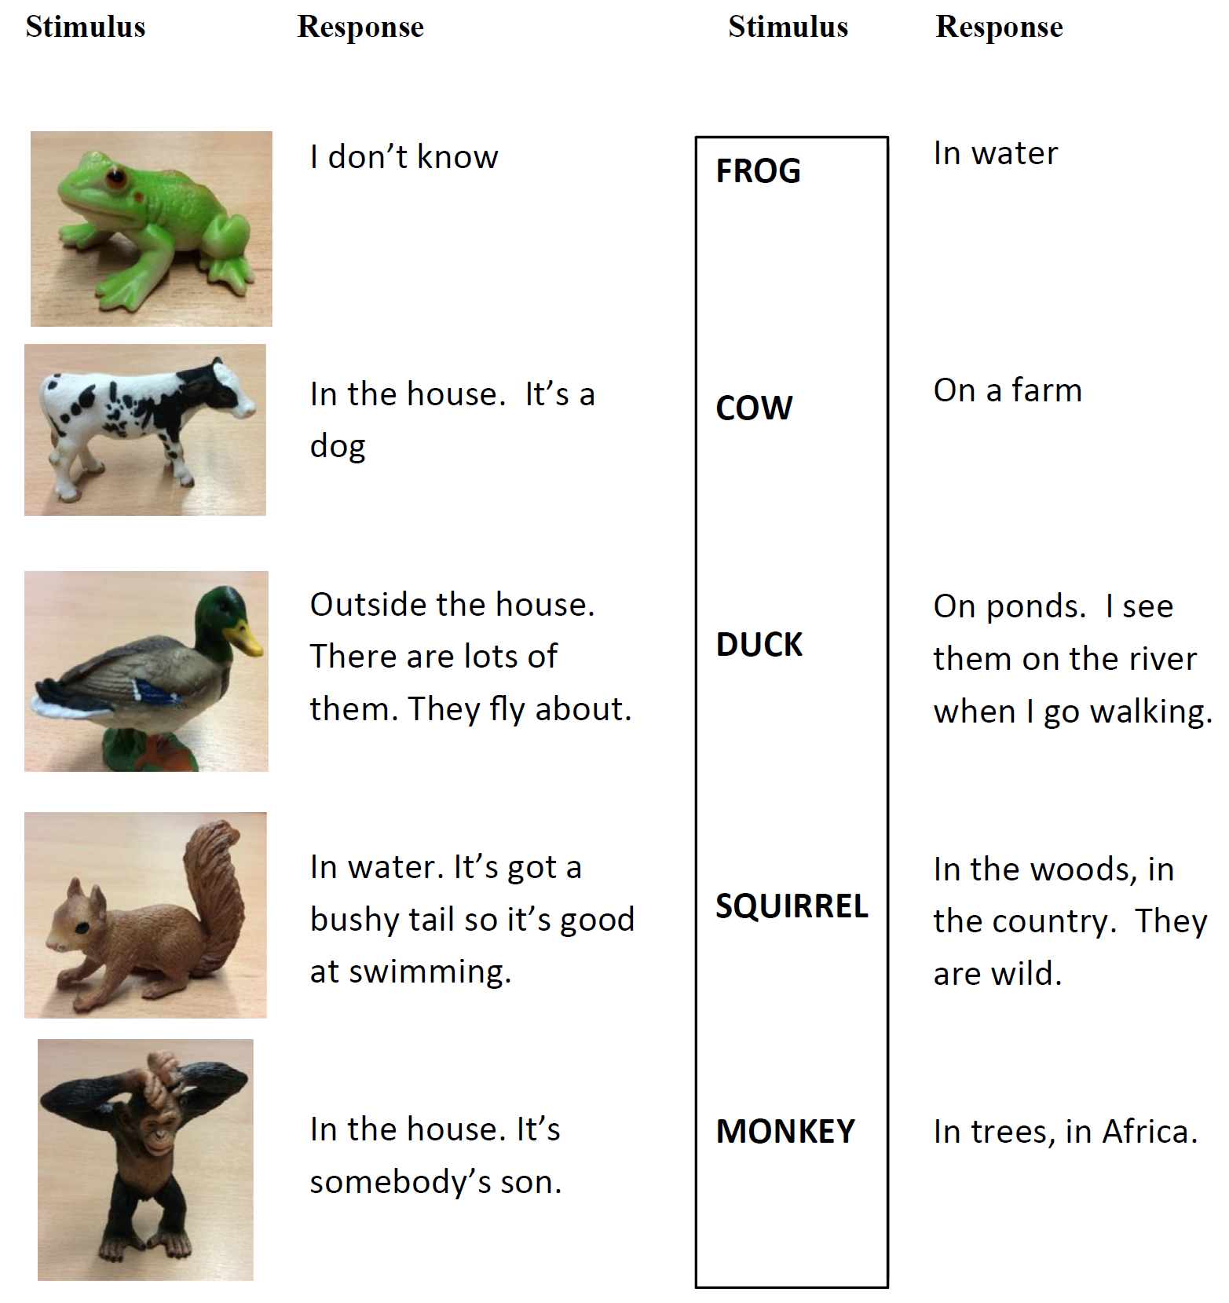
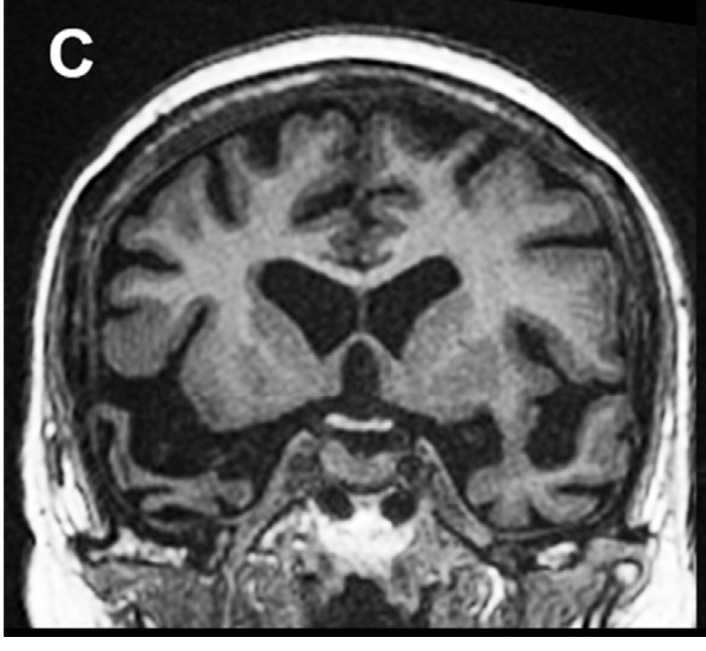
DNNs & Brain Damage
DL models of encoding and decoding have not yet been put through the brain-damage experiments. Ex. Semantic Dementia
Animal habitat task.
The patient is asked:
Where would you find this?
Do DL Models exhibit such degradation with damage to units?
Rt Ant Temporal Lobe Damage (Patient 8)
Snowden, Harris, Thompson, Kobylecki, Jones, Richardson, Neary (2018). Semantic dementia and the left and right temporal lobes, Cortex, 107(188-203).
https://doi.org/10.1016/j.cortex.2017.08.024.

Slide 9
Multilinguality
How do multilingual participants represent information?
Different language families and typologies (verb-framed vs satellite
Multiple scripts
How do brain activations align to modern LLMs that perform language translation among multiple languages apparently seamlessly?
Bi/Multilingual Advantage and what does it mean for DL models?
studies have shown superior executive function (inhibitory control), memory in multilingual participants
Potential representational differences in simultaneous and sequential multilinguals
Link between Language and Cognition
What can DL models contribute to Bi/Multilingual Literature?

Slide 10
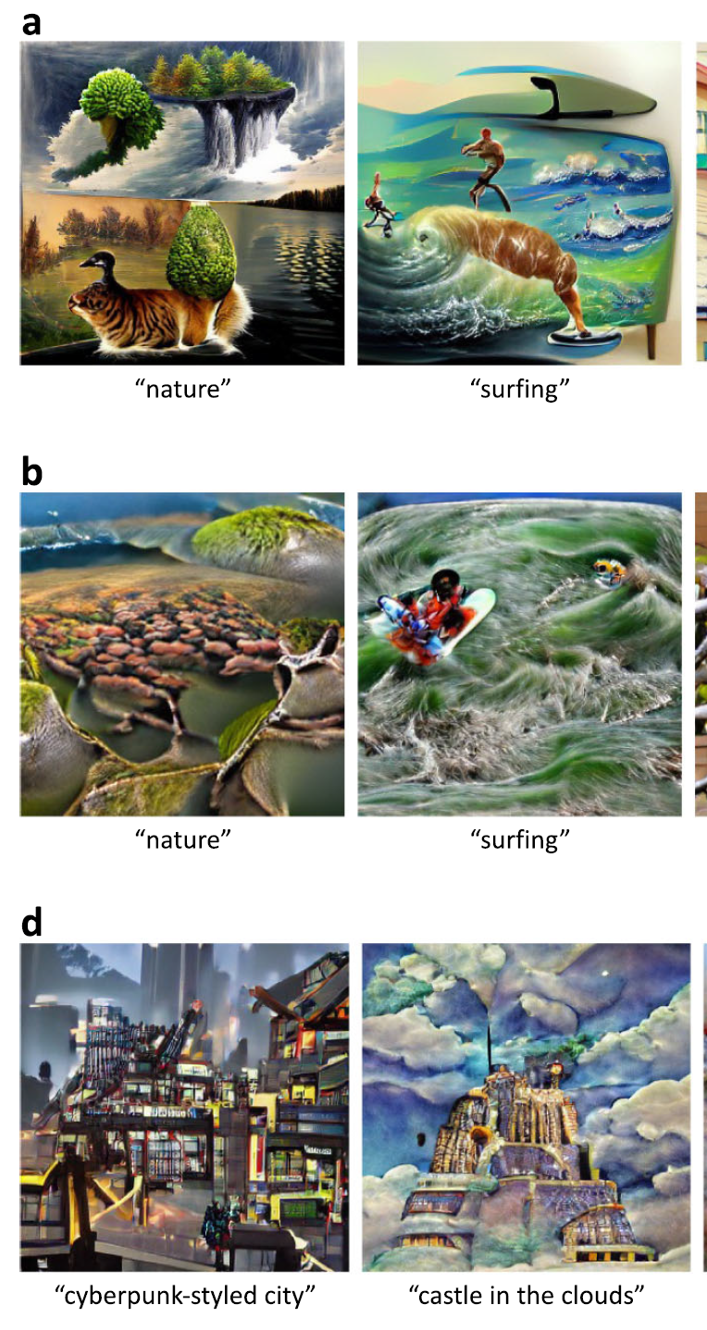
DNNs & Brain: Multi-modal, Multi-task
Brain response to a stimulus is multi-modal, multi-task related
Cross-view and multi-view decoding (Oota et al 2022)
Visio-linguistic encoding (fusion of vision and language information) (Oota et al 2022)
Multimodal foundation model (Fei et al 2022)
Fei, Lu, Gao et al (2022). Towards artificial general intelligence via a multimodal foundation model. Nature Communications 13:3094 doi.org/10.1038/s41467-022-30761-2

Slide 11
A big thank you!
Tutorial, Code and Material:
Material from IJCAI 2023 Tutorial would be uploaded soon!
(Past): Deep Learning for Brain Encoding and Decoding, Cogsci-2022
https://tinyurl.com/DL4Brain
(Past): Language and the Brain: Deep Learning for Brain Encoding and Decoding, IJCNN 2023
https://tinyurl.com/DLBrainIJCNN2023

